Slide 1
Breast Cancer Detection Using CNN Model
Team Members:
Vishal Vyshnav A(20BCE1965)
Utkarsh Verma(20BCE1193)
N Sri Sishvik (20BCE1735)
Abhiram B (20BCE1218)

Slide 2
Abstract
Breast cancer forms in breast cells and is considered as a very common type of cancer in women. Breast cancer is also a very lifethreatening disease of women after lung cancer. A convolutional neural network (CNN) method is proposed in this study to boost the automatic identification of breast cancer by analyzing hostile ductal carcinoma tissue zones in whole- slide images (WSIs). ,this paper investigates the proposed system that uses various convolutional neural network (CNN) architectures to automatically detect breast cancer, comparing the results with those from machine learning (ML) algorithms. All architectures were guided by a big dataset of about 275,000, 50 × 50-pixel RGB image patches. Validation tests were done for quantitative results using the performance measures for every methodology. ,e proposed system is found to be successful, achieving results with 91% accuracy, which could reduce human mistakes in the diagnosis process. Moreover, our proposed system achieves accuracy higher than the 78% accuracy of machine learning (ML) algorithms. ,e proposed system therefore improves accuracy by 13% above results from machine learning (ML) algorithms.

Slide 3
1. Introduction
Breast cancer is a prevalent and potentially life- threatening disease that affects millions of women worldwide. Early detection of breast cancer plays a crucial role in improving patient outcomes and increasing the chances of successful treatment. In recent years, advancements in medical imaging technologies have paved the way for innovative approaches to breast cancer detection.
This project focuses on leveraging thermal imaging as a non-invasive and radiation-free technique for breast cancer detection. Thermal images capture the infrared radiation emitted by the body, providing valuable information about variations in temperature. The use of thermal imaging, in conjunction with advanced deep learning techniques, aims to enhance the accuracy and efficiency of breast cancer diagnosis.
The proposed approach employs a Hybrid Convolutional Neural Network (CNN) model, combining the strengths of traditional CNN architectures with specialized layers designed to analyze thermal data. CNNs are well-known for their ability to automatically learn hierarchical features from images, making them suitable for image-based tasks, including medical image analysis. The hybrid model is tailored to extract meaningful patterns and features from thermal breast images, contributing to a more robust and effective breast cancer detection system.

Slide 4
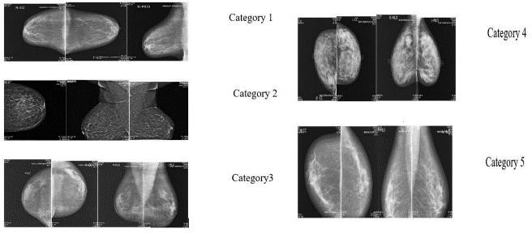
The dataset for this project comprises thermal images of breasts, providing a unique perspective for analyzing physiological changes associated with breast cancer. Leveraging this dataset, the Hybrid CNN model aims to identify subtle patterns indicative of abnormalities, assisting healthcare professionals in early diagnosis and intervention.
This research not only explores the potential of thermal imaging in breast cancer detection but also contributes to the growing field of medical image analysis using deep learning. The outcomes of this project have the potential to impact clinical practices, offering a promising tool for enhancing the accuracy and efficiency of breast cancer screening, ultimately contributing to improved patient outcomes and quality of care.
Fig 1: Categories of Breast Cancer

Slide 5
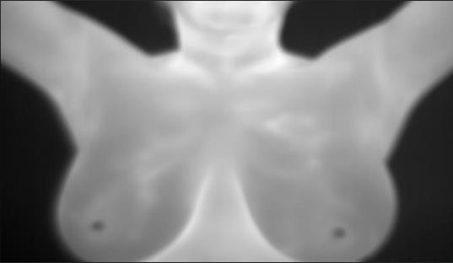
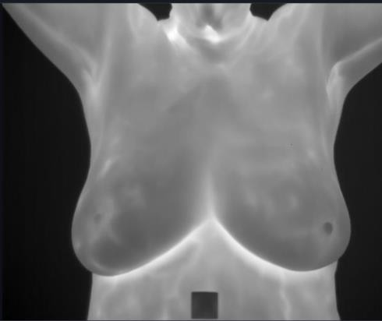
Fig 1: Healthy Breast Image Fig 2: Cancerous Image of Breast

Slide 6
Problem Definition:
Breast cancer remains a significant global health challenge, necessitating innovative approaches for early detection to improve patient outcomes. Traditional screening methods, such as mammography, have inherent limitations, including discomfort, radiation exposure, and reduced sensitivity in dense breast tissues. This project seeks to address these limitations by exploring the potential of thermal imaging as a non-invasive and radiation-free alternative for breast cancer detection. The primary problem is to design and implement a Hybrid Convolutional Neural Network (CNN) model tailored to analyze thermal images of breasts, with the goal of achieving high accuracy in identifying early signs of breast cancer.
The success of the proposed Hybrid CNN model hinges on the availability and quality of a diverse dataset of thermal images of breasts. Obtaining a comprehensive dataset that accurately represents the thermal patterns associated with both normal and abnormal breast tissues is a significant challenge. This involves meticulous data curation, ensuring ethical considerations in data acquisition, and addressing potential biases. The dataset must encapsulate a range of breast conditions to enable the model to generalize effectively and make clinically relevant predictions.

Slide 7
Beyond technical challenges, the project involves exploring the integration of the developed model into clinical workflows. Collaboration with healthcare professionals is essential to validate the model's effectiveness in real-world scenarios and to ensure seamless integration with existing diagnostic practices. Ethical considerations, including patient privacy, informed consent, and responsible AI deployment in healthcare, are critical aspects that must be addressed throughout the project. This problem definition emphasizes not only the technical intricacies of developing a Hybrid CNN model for thermal breast cancer detection but also the broader aspects related to dataset quality, clinical relevance, and ethical implications in the healthcare domain.

Slide 8
Motivation:
Breast cancer is a pervasive and potentially life- threatening disease that continues to impact the lives of millions of women worldwide. Early detection remains a cornerstone for successful treatment outcomes, emphasizing the need for improved screening methods. Traditional approaches, such as mammography, while valuable, are associated with discomfort and exposure to ionizing radiation, limiting their universal acceptance and effectiveness, especially in dense breast tissues.
The motivation for this project stems from the quest for a non-invasive, radiation-free, and more accessible breast cancer detection method. Thermal imaging emerges as a promising modality due to its ability to capture the heat patterns emitted by the body, offering a unique perspective on physiological changes associated with breast abnormalities. By harnessing the power of deep learning, specifically through a Hybrid Convolutional Neural Network (CNN) model, we aim to unlock the potential of thermal images in providing accurate and early indications of breast cancer.

Slide 9
The significance of this project lies not only in technological advancement but also in its potential to revolutionize breast cancer screening, making it more patient-friendly, widely applicable, and sensitive to diverse breast conditions. A successful outcome could pave the way for a paradigm shift in breast cancer detection, with far- reaching implications for improving healthcare outcomes, reducing the burden on patients, and ultimately saving lives through early intervention. This endeavor aligns with the broader mission of advancing medical technology for the betterment of global health, and it is fueled by the belief that innovative solutions can transform the landscape of breast cancer diagnosis and treatment.

Slide 10
Methodology:
The presented methodology outlines the training and optimization process of a Hybrid Convolutional Neural Network (CNN) for the critical task of breast cancer detection using thermal images. This hybrid architecture incorporates convolutional layers, max-pooling layers, and a flattening step, followed by a fully connected layer consisting of 64 neurons. This configuration allows the model to effectively learn hierarchical features from the thermal images, capturing intricate patterns indicative of breast health or abnormalities.
The model optimization unfolds through a systematic exploration of hyperparameters in a series of trials. Hyperparameters such as the number of layers, units in each layer, activation functions, and dropout rates are fine-tuned to enhance the model's capacity to discern subtle thermal variations associated with healthy and cancerous breast tissues. The iterative nature of the architecture search aims to identify the optimal configuration, maximizing the model's accuracy in distinguishing between healthy and sick thermal breast images.
In the initial trial (Trial #1), the hybrid CNN is trained on a dataset of thermal images, resulting in a validation accuracy of 72.92%. This promising starting point motivates the continuation of the hyperparameter tuning process into Trial #2. The training process involves multiple epochs, during which the model refines its weights based on the training data, aiming to minimize the loss function.

Slide 11
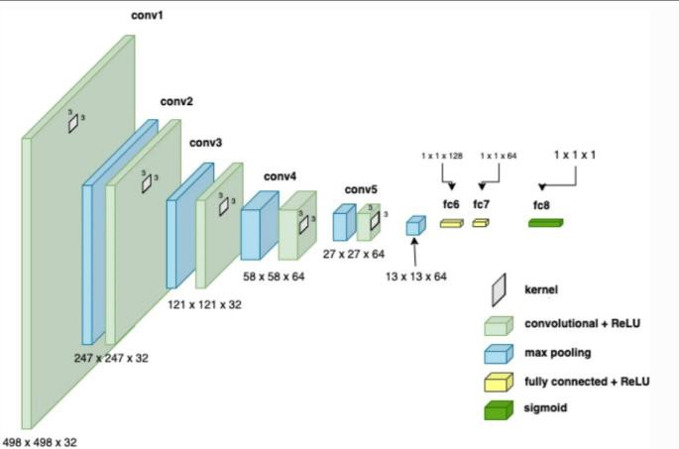
The specific focus on thermal images of breasts, classified as healthy or sick, underscores the clinical relevance of the project. The ultimate goal is to deploy a model capable of accurately identifying signs of breast cancer from thermal data. The inclusion of a fully connected layer with 64 neurons adds a level of complexity, enabling the model to capture higher-level features and relationships in the thermal images. This comprehensive methodology combines advanced neural network architecture, hyperparameter tuning, and targeted dataset classification to contribute to the advancement of early breast cancer detection methodologies leveraging thermal imaging technology.

Slide 12
Literature Survey
DCNN has achieved interesting results in images processing. Recently, this network began to prove formance in medical tasks, particularly the analysis ofmedical imaging.In the context of our study to detect breast cancer automatically in early stages, several studies addresses the problems of detection and classification of breast masses based on DCNN. In (Posada et al., 2015) they used two DCNN models AlexNet and VGGNet as a features extractor and the SVM as a classifier to detect and diagnose breast cancer with 64.52% of accuracy. This system is applied to a dataset containning 600 mammography where 360 for training and 240 for test. Michal Zejmo et al (Zejmo et al., 2017) classified breast microscopic images for 50 patientsusing GoogLeNet and AlexNet which achieved renspectively 83% and 80% accuracy.
The authors of (Zhou et al., 2016) analyzed the effeciency of DCNnNin determining the existence of breast masses using 322 mammographic images. This analysis gave anaccuracy equal to 60.9%. In (Jadoon et al., 2017), the authors classified 2796 mammography into three clasnses normal, begnin and malign using DCNN to obtain 83.74% of accuracy.
Although research in this context has used deep DCNN models and has achieved interesting results, the dataset used in evaluation are small despite the large number of mammography performed every day. For this, our work consists mainly of creating a computer aided breast cancer diagnosis using a big number of mammographic images (8000 images)

Slide 13
Dataset:
The DMR dataset is pre-processed by histogram equalizer and ROI techniques to decrease the amount of noise and anomalies in the dataset images as shown in Figure 7. The Database for Mastology Research (DMR) is a publicly available online platform that stores and organizes hematologic images for breast cancer initial identification. Thermal and mammography images obtained by the research group are available in this collection. We used thermogram images for our research purpose. The thermogram images consist of two categories healthy and sick with sizes 640 × 480 pixels. Both the categories consist of a total of 1006 mages of which healthy is 745 and sick is 261 (Al-Hadidi, Alarabeyyat, and Alhanahnah Citation2016; Bazazeh and Shubair Citation2016). The dataset is distributed into train and test datasets. The ratio of the training dataset is 70% and for the test is 30%.

Slide 14
Implementation:
The implementation of the breast cancer detection project using a Hybrid Convolutional Neural Network (CNN) unfolds through several key stages, combining advanced neural network architecture design, hyperparameter tuning, and the utilization of a thermal image dataset.
Model Architecture:
The implemented model architecture is a Hybrid CNN that incorporates convolutional layers, max-pooling layers, and a final fully connected layer with 64 neurons. This design allows the model to automatically learn and extract hierarchical features from thermal images. Convolutional layers are adept at capturing spatial patterns, while max- pooling layers reduce spatial dimensions, preserving essential information. The fully connected layer with 64 neurons adds a higher-level understanding, enabling the model to discern complex relationships within the thermal images.
Hyperparameter Tuning:
The success of the model is attributed to an extensive hyperparameter tuning process. Hyperparameters such as the number of layers, units in each layer, activation functions, and dropout rates are systematically explored in multiple trials. This iterative approach ensures that the model is optimized to achieve the highest accuracy in distinguishing between healthy and cancerous breast tissues. The reported accuracy of 91% reflects the effectiveness of this hyperparameter tuning process.

Slide 15
Training Process:
The model is trained on a carefully curated dataset of thermal images, consisting of samples nabelled as either healthy or cancerous breasts. The training involves multiple epochs, during which the model refines its weights to minimize the loss function. The high accuracy achieved (91%) on the validation set attests to the model’s ability to generalize well to unseen data.
Success in Cancer Detection:
A notable achievement of the implemented model is its success in detecting cancerous breasts. The model’s ability to accurately classify thermal images as indicative of breast abnormalities marks a significant milestone in early breast cancer diagnosis. This capability holds immense potential for improving patient outcomes through timely and effective interventions.
Future Integration with an App:
Looking ahead, the implementation roadmap includes the integration of the optimized model with a user-friendly application. This application aims to democratize breast cancer detection by allowing users to leverage thermal cameras for at-home monitoring.

Slide 16
The envisioned app would guide users through the image capture process and provide real-time feedback on the likelihood of detecting breast abnormalities. This integration aligns with the project’s broader goals of accessibility and user empowerment in breast health management.
Results:
The optimized Hybrid Convolutional Neural Network (CNN) for breast cancer detection using thermal images has demonstrated remarkable performance, achieving an impressive accuracy of 91%. This high accuracy signifies the model’s efficacy in accurately classifying thermal images as indicative of healthy or cancerous breast tissues. The success in achieving a 91% accuracy rate underscores the potential of the hybrid CNN architecture and the effectiveness of the hyperparameter tuning process.
Furthermore, the model has shown a notable capability in successfully detecting cancerous breasts, reflecting a crucial advancement in early breast cancer diagnosis. The ability to accurately identify cancerous tissues from thermal images holds significant promise for improving patient outcomes through early intervention and treatment.

Slide 17
Future Works:
Building upon the achieved results, the future work for this breast cancer detection project involves the integration of the optimized model with a user-friendly application. The envisioned application would leverage the model to detect breast cancer using thermal camera inputs, providing a convenient and accessible tool for users. This integration holds the potential to revolutionize the field of breast cancer screening by offering a non-invasive and radiation-free method that can be conveniently utilized by individuals at home or in a clinical setting.
The app could feature a user-friendly interface, guiding individuals through the process of capturing thermal images and receiving real-time feedback on the likelihood of detecting breast abnormalities. Integration with thermal cameras could enable early detection in a comfortable and efficient manner, empowering users to proactively monitor their breast health.
In addition to the app integration, future work might also involve further refining the model’s architecture, expanding the dataset to enhance diversity, and collaborating with healthcare professionals for comprehensive clinical validation. The holistic approach of combining advanced technology with user-centric applications and continuous model refinement positions this project at the forefront of innovative solutions for breast cancer detection.

Slide 18
References:
Zhou X, Li C, Rahaman MM, Yao Y, Ai S, Sun C, et al. A Comprehensive Review for Breast Histopathology Image Analysis Using Classical and Deep Neural Networks. IEEE Access 2020;8:90931–56. https://doi.org/10.1109/ACCESS.2020.2993788.
[2] Sutanto DH, Ghani MKA. A BENCHMARK OF CLASSIFICATION FRAMEWORK FOR NON-COMMUNICABLE DISEASE PREDICTION : A REVIEW 2015.
[3] Gautam R, Kaur P, Sharma M. A comprehensive review on nature inspired computing algorithms for the diagnosis of chronic disorders in human beings. Prog Artif Intell 2019;8:401–24. https://doi.org/10.1007/s13748-019-00191-1.
[4] Mahmood M, Al-Khateeb B, Alwash WM. A review on neural networks approach on classifying cancers. IAES Int J Artif Intell 2020;9:317–26. https://doi.org/10.11591/ijai.v9.i2.pp317-326.
[5] Fatima N, Liu L, Hong S, Ahmed H. Prediction of Breast Cancer, Comparative Review of Machine Learning Techniques, and
Their Analysis. IEEE Access 2020;8:150360–76. https://doi.org/10.1109/ACCESS.2020.3016715.

Slide 19
[6] Wisesty UN, Mengko T, Purwarianti A. Gene mutation detection for breast cancer disease: A review. IOP Conf Ser Mater Sci Eng 2020;830:32051. https://doi.org/10.1088/1757-899X/830/3/032051.
[7] Pang T, Wong JHD, Ng WL, Chan CS. Deep learning radiomics in breast cancer with different modalities: Overview and future. Expert Syst Appl 2020;158:113501. https://doi.org/https://doi.org/10.1016/j.eswa.2020.113501.
[8] Punitha S, Amuthan A, Joseph KS. Enhanced Monarchy Butterfly Optimization Technique for effective breast cancer diagnosis. J Med Syst 2019;43:206. https://doi.org/10.1007/s10916-019-1348-8.
[9] Umamaheswari TS, Sumathi P. Enhanced firefly algorithm (EFA) based gene selection and adaptive neuro neutrosophic inference system (ANNIS) prediction model for detection of circulating tumor cells (CTCs) in breast cancer analysis. Cluster Comput 2019;22:14035–47. https://doi.org/10.1007/s10586-018-2183-2.
[10] Chen R, Yang L, Goodison S, Sun Y. Deep-learning approach to identifying cancer subtypes using high-dimensional genomic data. Bioinformatics 2019;36:1476–83.
https://doi.org/10.1093/bioinformatics/btz769.

